Slide 1
INTRODUCTION TO SOFT SYSTEM THINKING
SELİN ÜNAL

Slide 2
Outline
Introduction
Nature of Soft Sytems
Soft Systems Thinking
Soft Systems Methodology and Case Study
Analyst’s Role
Rich Pictures
Relevant Systems And Root Definitions
Conceptual Models
Taking Action

Slide 3
Previously…
Hard Systems are
Well-defined, concrete subsystems
Outcomes are predictable and quantifiable
People are only involved in a predictable and simplified way
People do not have self purposes

Slide 4
The Nature of Soft Systems
Each individual is unique in the way of they
Think
Behave
Understand
Interpret the things
World view made up complex set of
Attributes
Beliefs
Values
Opinons
Perceptions

Slide 5
Soft System Thinking
Construction of organizational projects are faced with a challenge because of the ‘human’ factor that made things problematic or ‘messy’
This problems are considered to problematic due to the unknown variables that exists in the problem
An organizational way of thinking or methodology is required to help us understand these unknowns and how to deal with them
System methodologies revolve around helping people examining human involved problematic or ‘messy’ situations and its causes
Tries to solve complicated organizational problems

Slide 6
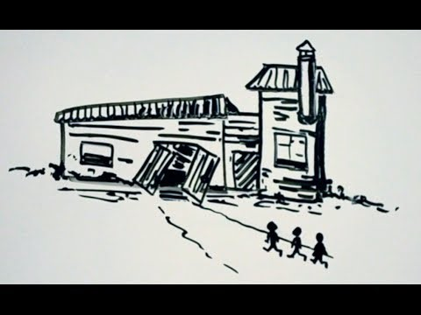
An Example Viewpoint

Slide 7
Soft Sytem Methodology
Soft = ‘People’
System = ‘We can apply theory of systems’
Methodology = ‘Organizational way of thinking’
This methodology can be applied to
Change management
Planning for health and medical systems
Information systems planning
Human resource management
Analysis of logistic systems
Expert systems development
In general we can use this methodology in knowledge management, project management, engineering and construction management

Slide 8
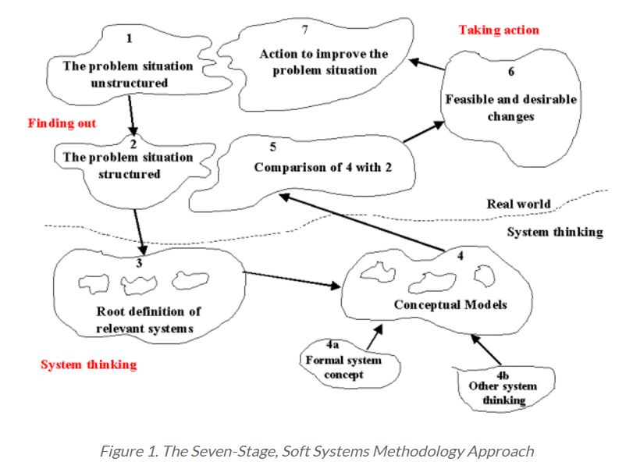
Soft System Methodology
Information about problem situaiton
Drawing rich picture, identifying issues and primary tasks
Root definitions and constructing conceptual models
Debating with actors
Action for change

Slide 9
Case Study – Complexity of Parking Enforcement
Parking problem in the city
Too many cars on the streets
Cars are parked inappropriate places
Pedestrians at risk
Car parks are full
Angry car owners, drivers
Angry pedestrians
Desperate employees

Slide 10
Analyst’s Role
Interview with participants
Be neutral about all your opinion
Be aware of the actors’ emotional situations about their answers
Maybe they are angry about a situation and because of that they can not give an exact answers about questions
Try to find out what is the participant’s expectation and dissatisfaction about the situation
Try to include all of the aspects of the situation
Try to understand, in as wide and holistic a sense as possible
Think about the factors which affect the situation

Slide 11
Step 1: Understand the Problem Situation
Most critical points at this step
Understanding the relationships, elements, and main activities involved in a problem situation
Deciding a boundary within which the situation can be improved
Drawing rich pictures
To help analysts and participants to piece the problem situation together
The point of rich picture diagram is
To explore various aspects of the situation, without trying to structure or analyze it

Slide 12
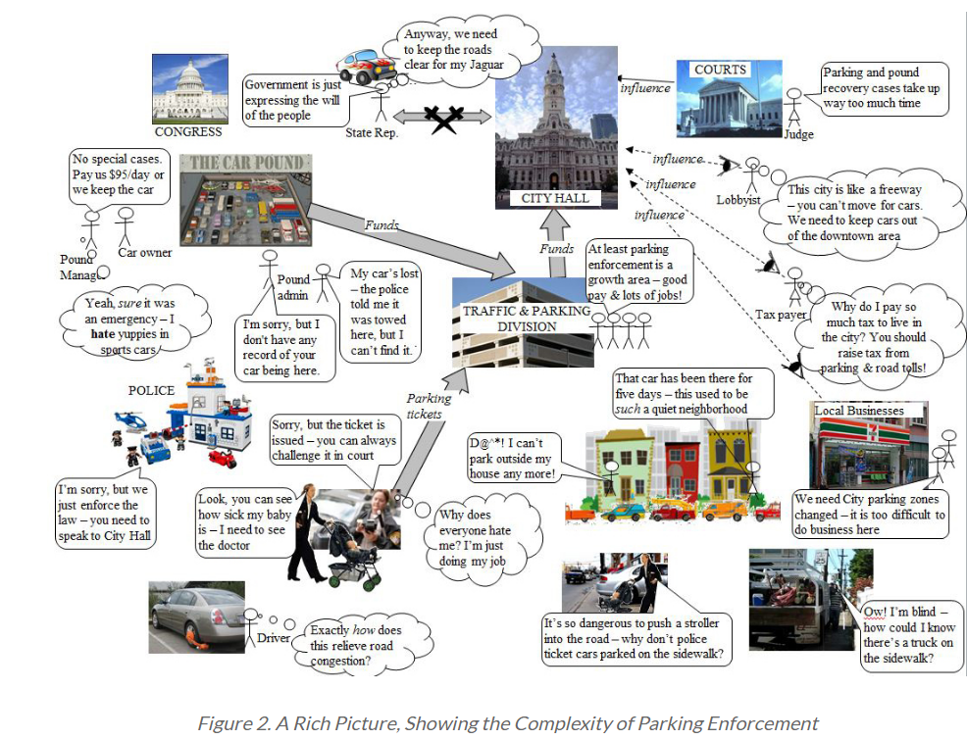

Slide 13
Rich Picture - Important Notes
In order to include all aspects of a situation, you can not represent everything in great detail, or all of the links between aspects of the situation
Just put in the main links and try to include as many points of view as you can
Drawing rich pictures makes you (the analyst) think of factors which affect the situation
the more you draw, the more you are stimulated to new ideas by what you have drawn
If you are performing a SSM analysis with a client, ask them to draw pictures
You do not have to draw a limited number of rich pictures
Examine what is not there at present, as well as what is there

Slide 14
Sources of Rich Picture
You (the analyst) can collect information for rich picture through
Example reports
Interviews
Meetings
Clients

Slide 15
Step 2: Structure The Situation By Defining Relevant Purposeful Systems
Define relevant systems that represents the messiness of the sitiuation
Represent multiple purposes of the system
By seperating purposes of the system we can model the system without conflicting subsystems’ purposes with each other
Define set of transformations (Input/ Output transform diagrams)
Look at the system from as many “angles” as possible
Include people from all levels of management and work, from all areas of the organization

Slide 16
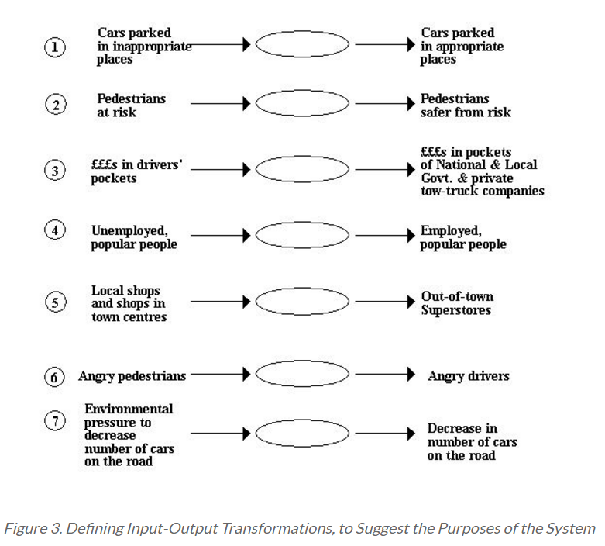
Think about the transformations from the perspective of the “owner” of the complete traffic management scheme – State or City Government

Slide 17
Step 3: Clarify what the system exists to achieve by defining Root Definitions of relevant systems of activity
Define root definitions ‘the root purpose’ of the system
It uses CATWOE framework for each transformation defined earlier
C: Customer -> who receive the output from the transformation
A: Actor -> Those individuals who would DO the activities of the transformation
T: Transformation ->The purposeful activity expressed as a transformation of input to output
W: Weltanschauung: It is a German word that literally means “world view”. It is the belief that makes sense of the root definition
O: Owner: the wider system decision maker who is concerned with the performance of the system
E: Environmental Constraints: the key constrains outside the system boundary that are significant to the system

Slide 18
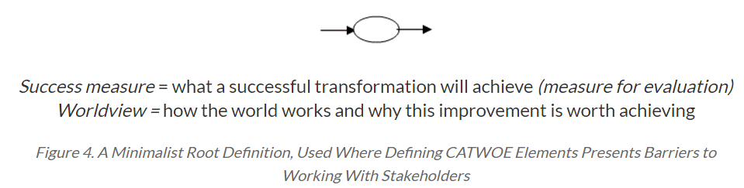
When working with business people it may be difficult for them to define the CATWOE elements for each transformation
In our case we will use minimalist root definition

Slide 19
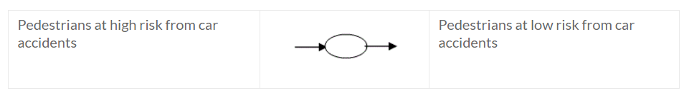
Root Definition for Transformation 2
Worldview : Pedestrian safety should have priority over driver convenience and drivers will not consider pedestrian safety unless they fear punishment
Success Criteria : Reduce accident rate by at least 50% over 5 years

Slide 20
Step 4: Deriving Conceptual Model
Derive conceptual model for analysing what the actors need to do in order to achieve that transformation
First define the activities, then produce a model that shows how these activities feed into each other

Slide 21
Defining Conceptual Model for Transformation 2
First define the activities
1. Determine places where parking causes danger to pedestrians.
2. Sign those places where parking is not permitted.
3. Monitor parking in those places.
4. Record drivers parking in those places.
5. Collect fines from punishment.
6. Fund the additional monitoring with collected fines.
7. Measure the number and locations of pedestrians involved in accidents.
8. Assess the impact upon pedestrian safety
9. Report to the public on the results.

Slide 22
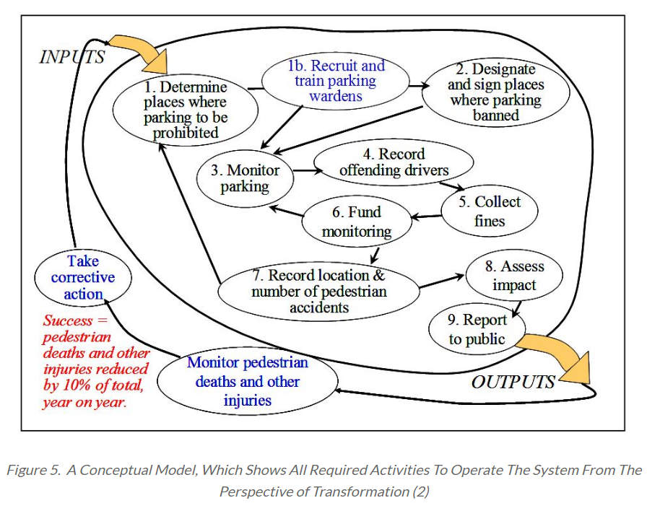
After that construct conceptual model

Slide 23
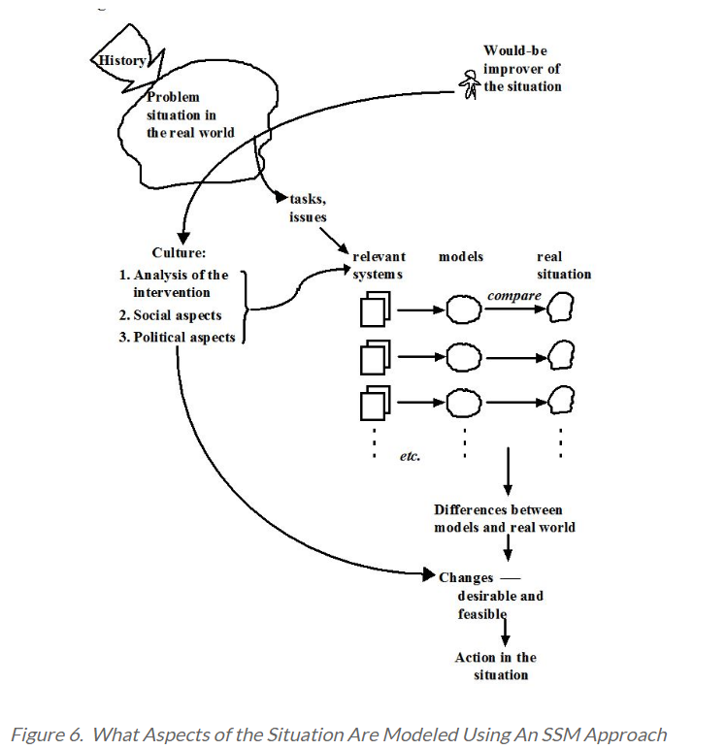
Step 5: Comparing Conceptual Models With The Real World
Provide a solid set of prioritized recommendations for what changes need to be made to existing activity systems
It is helpful to involve participants in this process

Slide 24
Taking Transformation 2
There is no monitoring system on the street : Action : Fund to monitoring system
There are cars on the sidewalk : Action : Put punishment, get fine
There are limited pedestriant crossing : Action : Build new pedestriant crossing

Slide 25
Step 6: Analyzing Feasible And Desirable Change
You are not the person who will implement the change
The system owners and actors have to live with these changes and make sure that they are happy with them and consider them appropriate
There are three elements that need to be considered
Feasibility: which changes are feasible and which are not
Cultural feasibility
Technical feasibility
Dependencies between work-systems and between technical systems
Win-win: does the change make life easier for people
Priority: Which changes are the most important ones
Risk analysis: Highest scores indicate risks/benefits that need managing carefully

Slide 26
Step 7: Taking Action
When implementing a change
Do not try to change everything at once
Plan a set of incremental changes
Involve the people actually working in the activity system
If you do not it is likely that these will be a dramatic failure

Slide 27

Thank you for listening ☺

